Slide 1



Generating Images with Multimodal Language Models
NIPS 2023
汇报人：王俊皓

Slide 2
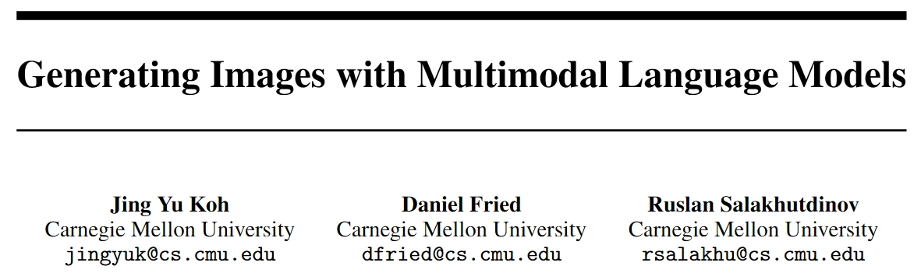

Background

Slide 3
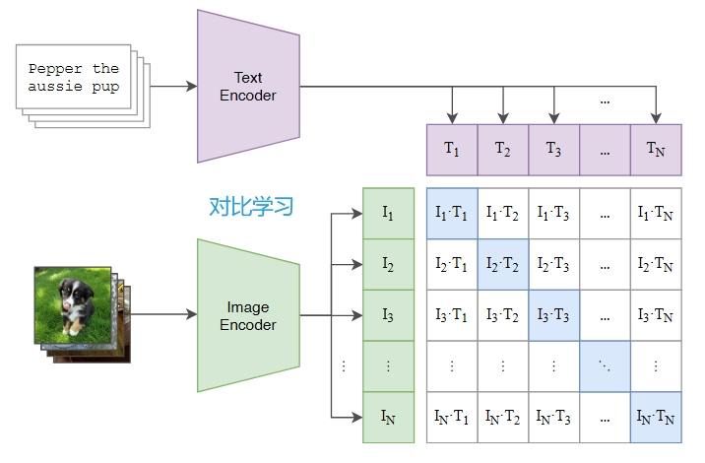
Background
Requires a lot of GPU resources → Lightweighting
Image Generation → Image Generation + Image Retrieval
Handle image and text embedding separately → Interleaved image and text
Notes:
现在很多做图像文本多模态的工作都是基于clip的工作来做的，
主要问题：数据集庞大需要的GPU资源很多，一般人没有那么多资源很难实现→轻量化
图像生成→图像检索+生成
分别处理文本和图像嵌入→文本图像交织

Slide 4
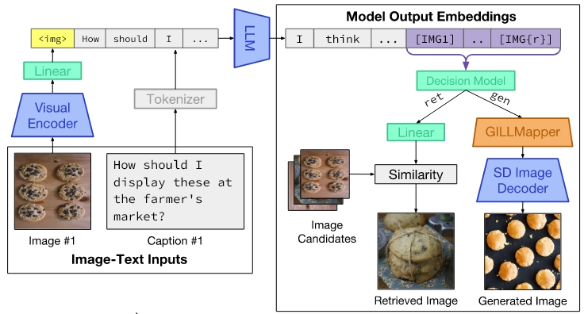
Background
①
④
③
②
Notes:
GILL模型架构

Slide 5
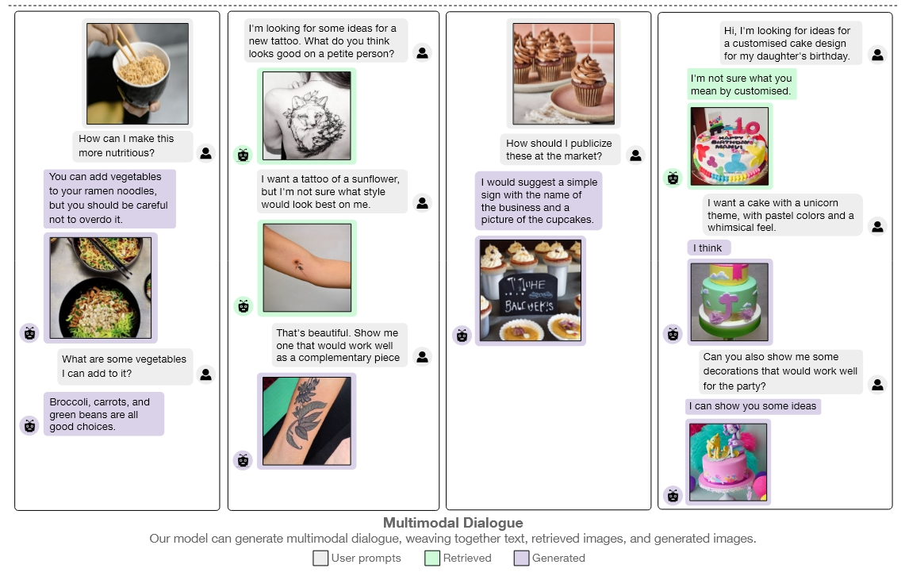
Background

Slide 6
Contributions
(Generating Images with Large Language Models (GILL)) Ours is the first approach capable of conditioning on arbitrarily interleaved image and text inputs to generate coherent image (and text) outputs.
In addition to novel image generation, our model is also capable of image retrieval from a prespecified dataset, and decides whether to retrieve or generate at inference time.
Our model exhibits a wider range of capabilities compared to prior multimodal language models.
Notes:
作者说他们是第一个能够对任意交错的图像和文本输入进行调节，以生成连贯的图像（和文本）输出的方法。

Slide 7
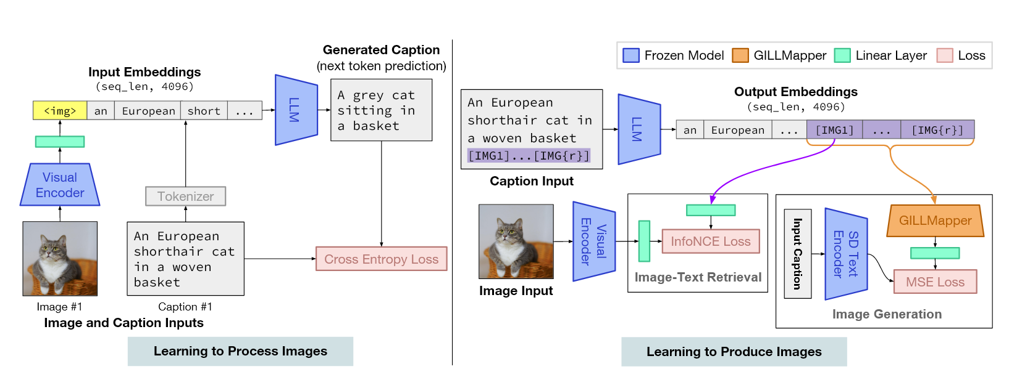

Method
①
Our goal is to adapt a frozen LLM to enable it to complete any sequence of arbitrarily interleaved image and text inputs. For example, inputs for the Visual Storytelling dataset consist of 5 images and 5 text descriptions, interleaved in a manner such as (x1, y1, . . . , x5, y5).
Learning translation parameters that map from image features to text embedding space.

Slide 8
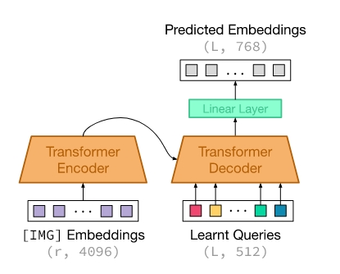
Method
②
Notes:
GILLMapper将LLM输出的图像嵌入转换成预测的文本嵌入，
然后将这个文本嵌入与图像生成模型的文本嵌入结果计算MSE Loss来训练GILLMapper

Slide 9
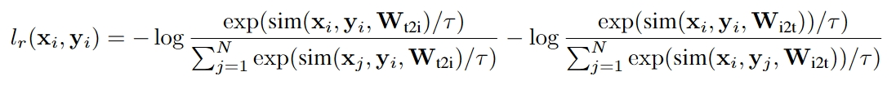
Method
③
Notes:
将IMG1图像嵌入映射到检索空间
将图片经过编码器后的输出映射到检索空间
然后计算InfoNCE Loss

Slide 10
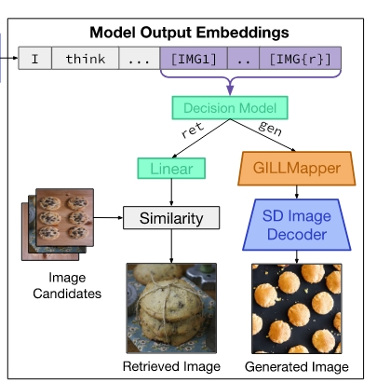
Method
④We have 5 independent human annotators select which of the two images for each prompt, retrieved or generated, is better matched to the prompt. We labeled the examples where the generated image was selected as ‘gen’ (indicating prompts which we should generate an image for) and ‘ret’ for prompts that should have an image retrieved.
④

Slide 11
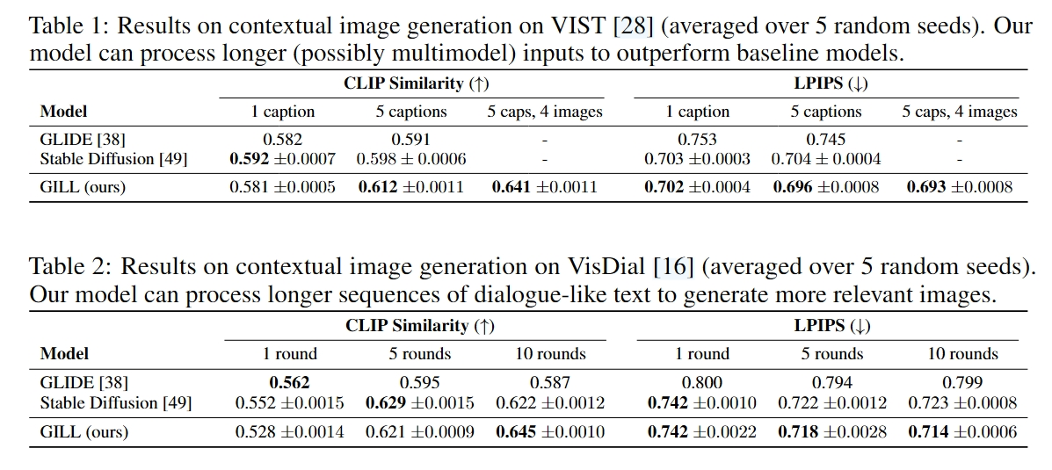
Evaluation
CLIP Similarity: We use the CLIP ViT-L image encoder to produce pooled representations of generated images and the corresponding real images, and report their cosine similarity.
LPIPS : LPIPS evaluates the distance between image patches. We measure LPIPS between real and generated images.

Slide 12
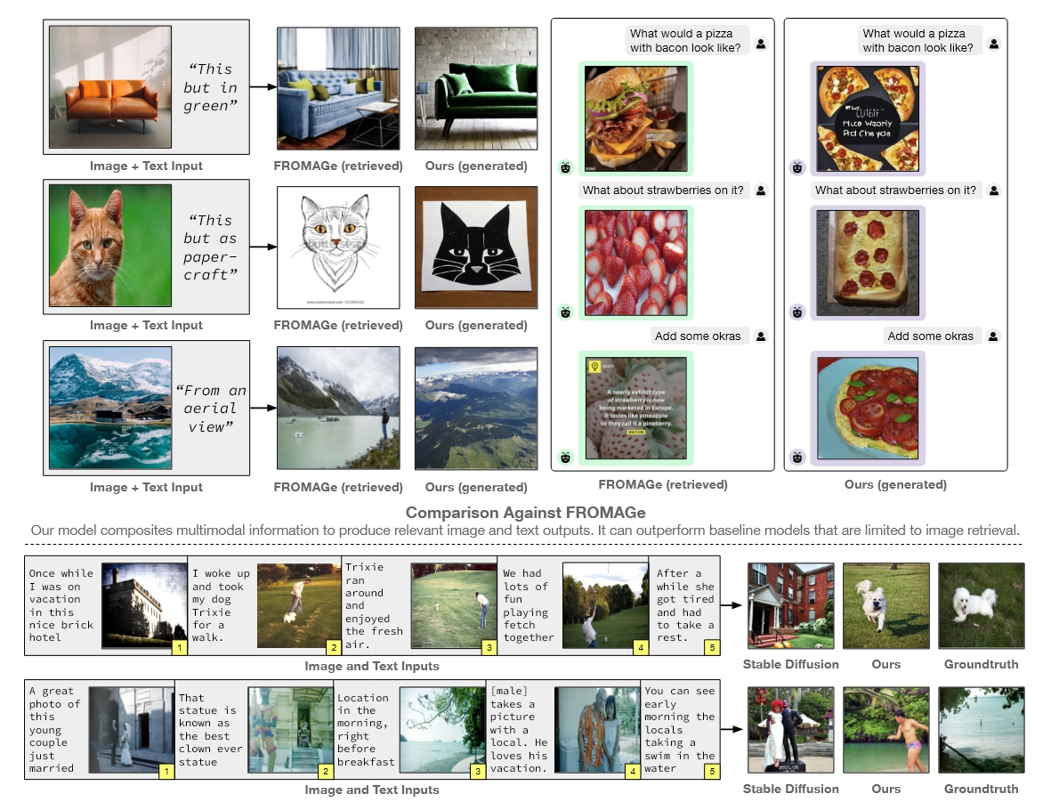
Evaluation
We observed that GILL is able to outperform retrieval models such as FROMAGe [31] on examples where FROMAGe is unable to retrieve relevant images. GILL is also generally more sensitive to input context compared to Stable Diffusion [49], and can condition on image inputs, in addition to text, to generate more visually and semantically relevant image outputs.

Slide 13
My harvest
Mapping module
Choosing the suitable comparison work

Slide 14
End
Thanks For Listening

